Slide 1

How to Turn your
Github into a Lithub
Optionally: How to git gud

Slide 2
What is Github?
It’s a method to save your code and upload it to the cloud
Version Control
It remembers your past edits and keeps your project’s history.
Collaborative
Github makes it very easy to share your programs

Slide 3
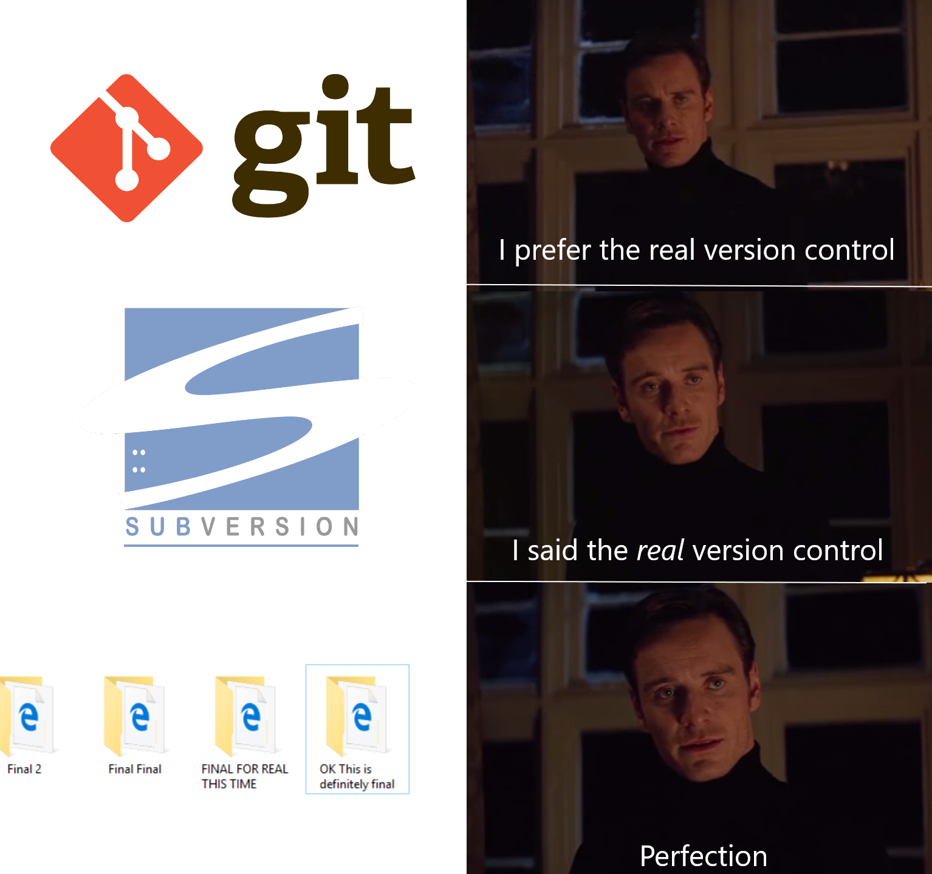

Slide 4
Why should you Learn Github?
All your code is on the cloud.
Almost every company/group uses Github.
It works with any language.
It works with any operating system
It allows you to share your code with others.
Two people can program the same project at the same time.

Slide 5
How to create an account
Go to https://github.com/
Please sign up with your school email. This will be important later.
When signing up, pick the free option, you do not need to pay anything to use github.

Slide 6
Download Git Bash
Go to: https://git-scm.com/downloads
Pick whatever operating system you are using
The room’s computers should have them installed.

Slide 7
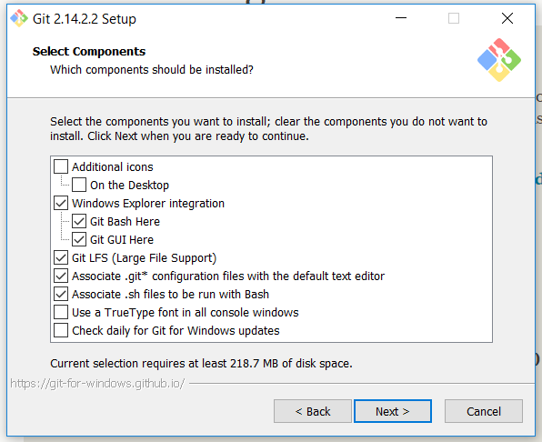
Make Sure these boxes are selected (they should be by default)

Slide 8
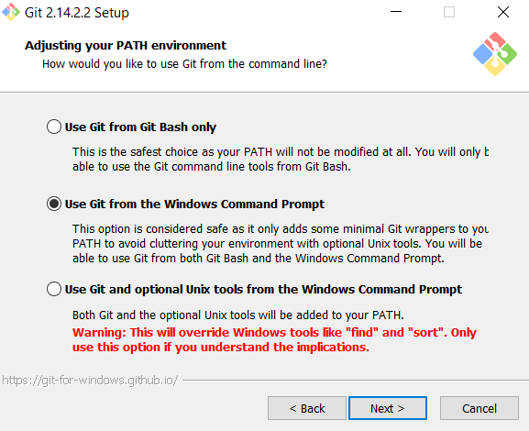

Slide 9
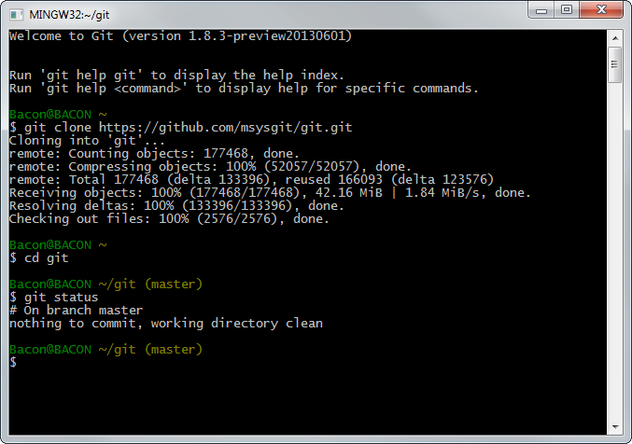
Now for the fun stuff

Slide 10
Learning how to use a terminal
It’s basically a text based adventure game, without the fun.
Very similar to Window’s command prompt

Slide 11

Home Directory
Working Directory

Slide 12
Commands to know
mkdir - make a new directory
mkdir projects
cd - change directory
cd c:\Users\
cd .. goes backwards to parent directory c:\
ls - list all files in the directory

Slide 13
Understanding how the terminal works
Think of a directory like a room
Unless you give the specific location of the item you want to use, you can only access things in that particular room (directory)
You can only get to some rooms by going through others.
Keep in mind when typing out locations if the location has a space in it, you need to add quotes around the location eg: “C:/Program Files/”

Slide 14
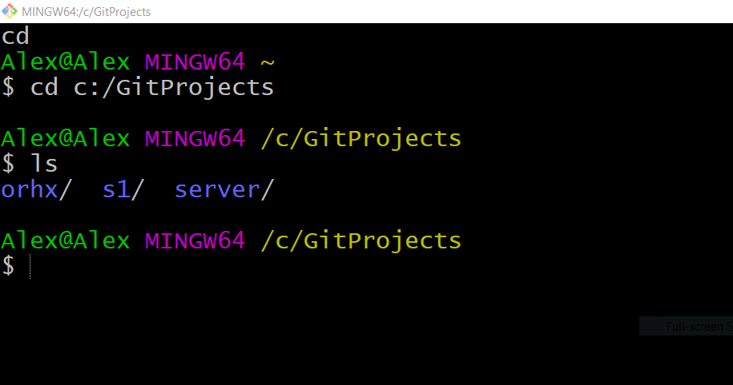
Specific location to the file
Files I can interact with w/out specifying a certain location.

Slide 15
Git-specific commands
Every git-specific command will have the keyword “git” in front of it.
git init - Creates an empty git repository
git add - Adds files to the staging area
git commit - records changes to the repository
git push - moves local changes to the remote repository (cloud)
git pull - Download changes from remote repository (download and combine)
There are plenty more commands but these are the main five and the ones we’re going to focus on for right now.

Slide 16
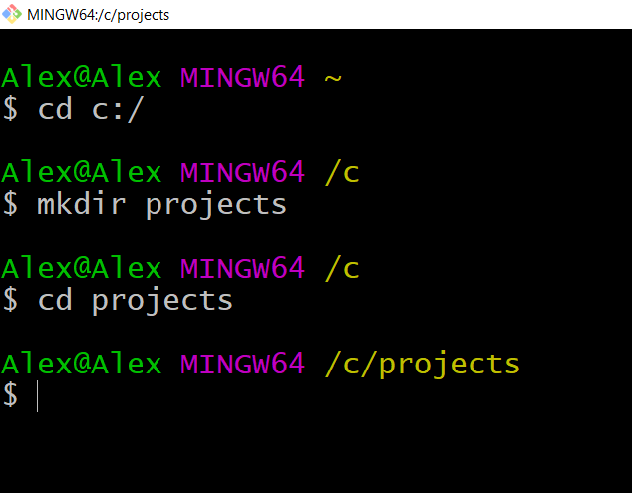
Create your first Repository
Navigate to your C:/ Drive
Make a new directory and give it a name, something like GitProjects or projects etc. (A projects folder here is optional, we do it at c:\ so we don’t have to do too much typing)
Navigate to that new GitProjects folder

Slide 17
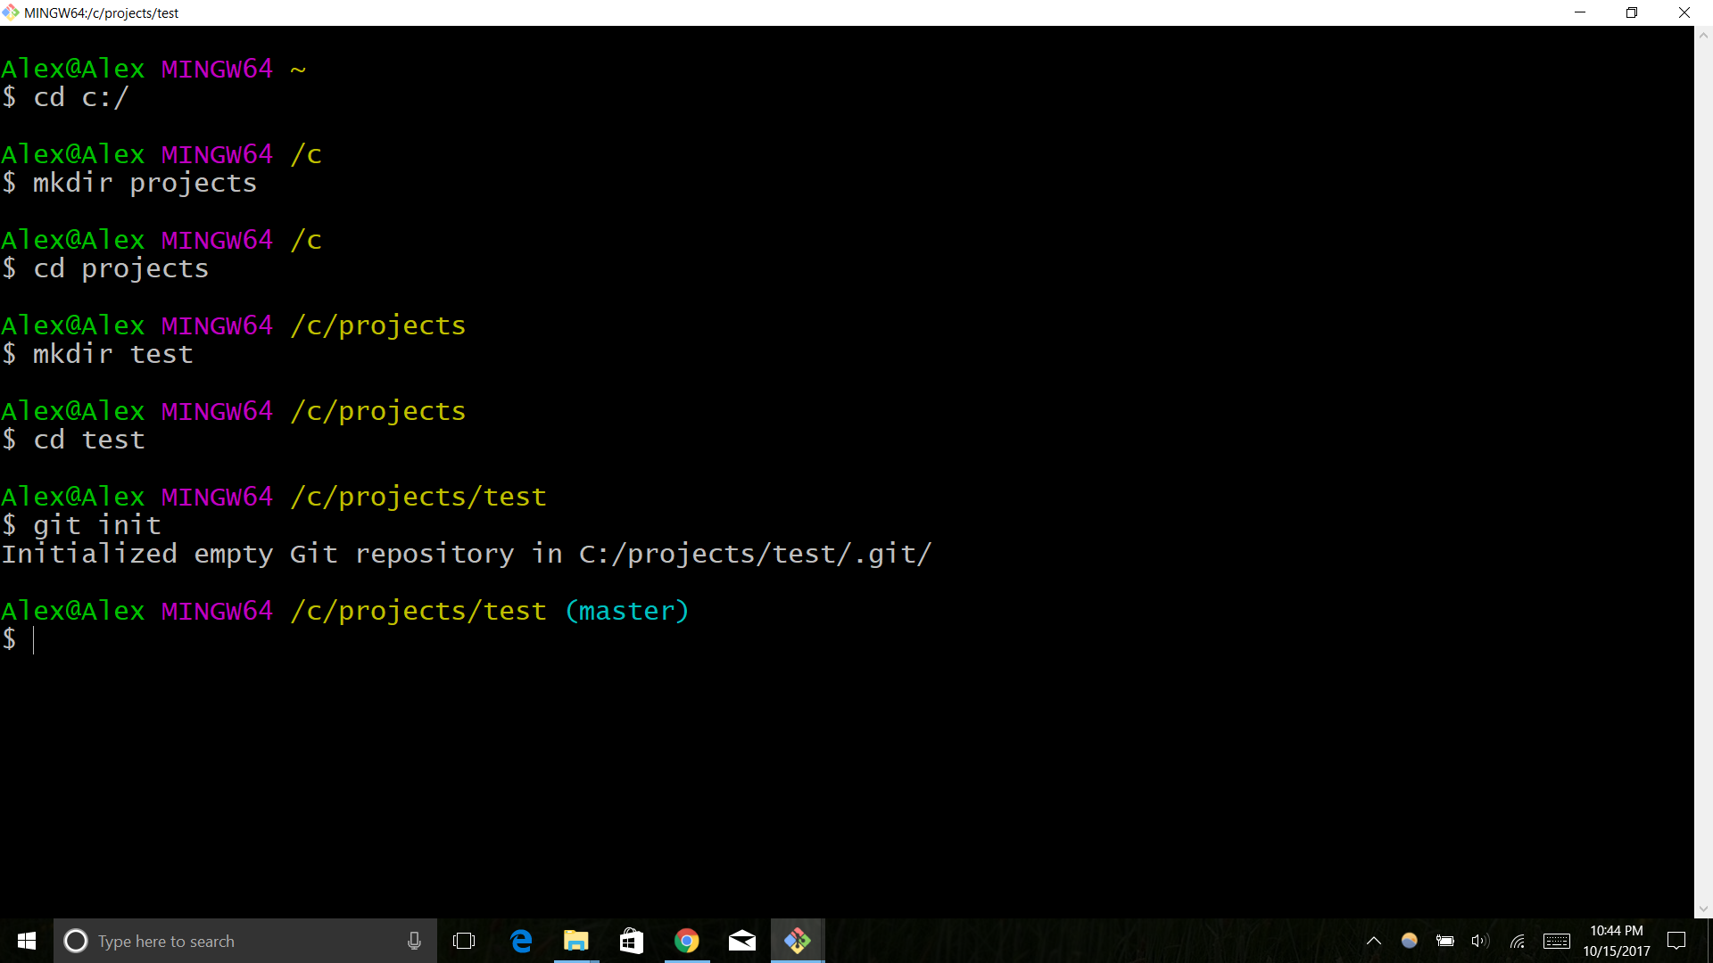
Create Your First Repository
Make another directory and title it “test”
Navigate to that test folder
Initialize an empty git repository

Slide 18
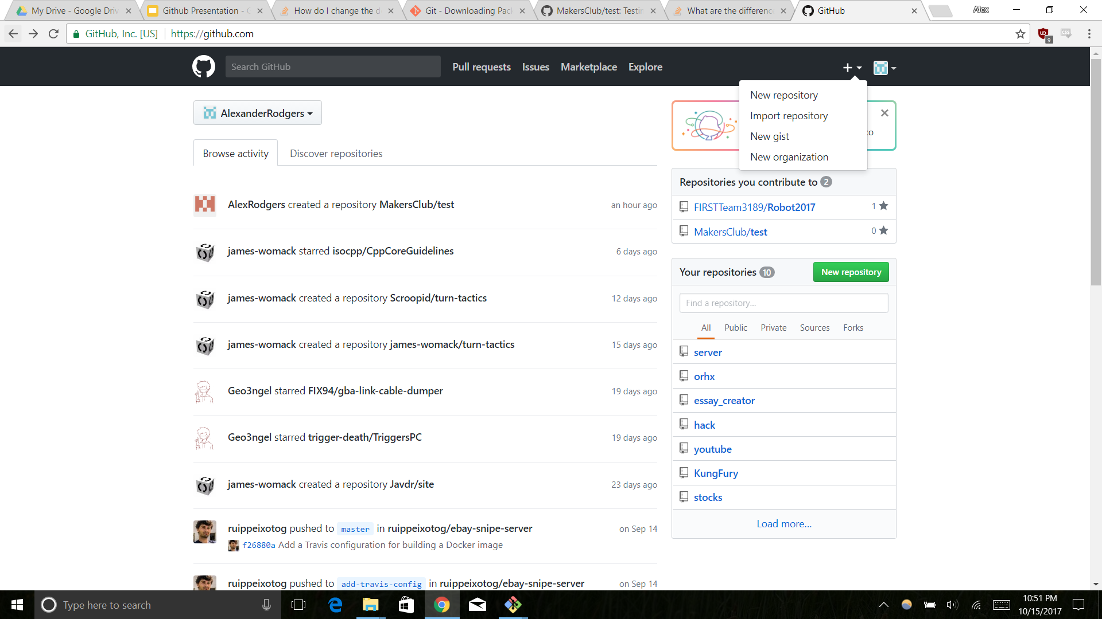
Create your First Repository
-Click the + button
-Select New repository

Slide 19
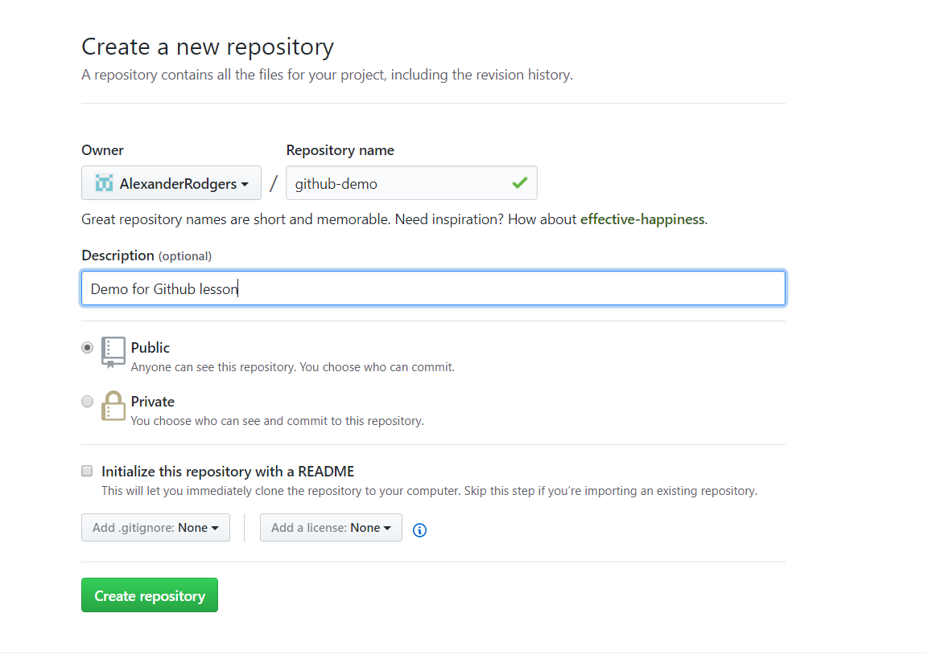
Create your First Repository
Give your repository a name and description.
Select public under the repository description
Press the green create button

Slide 20
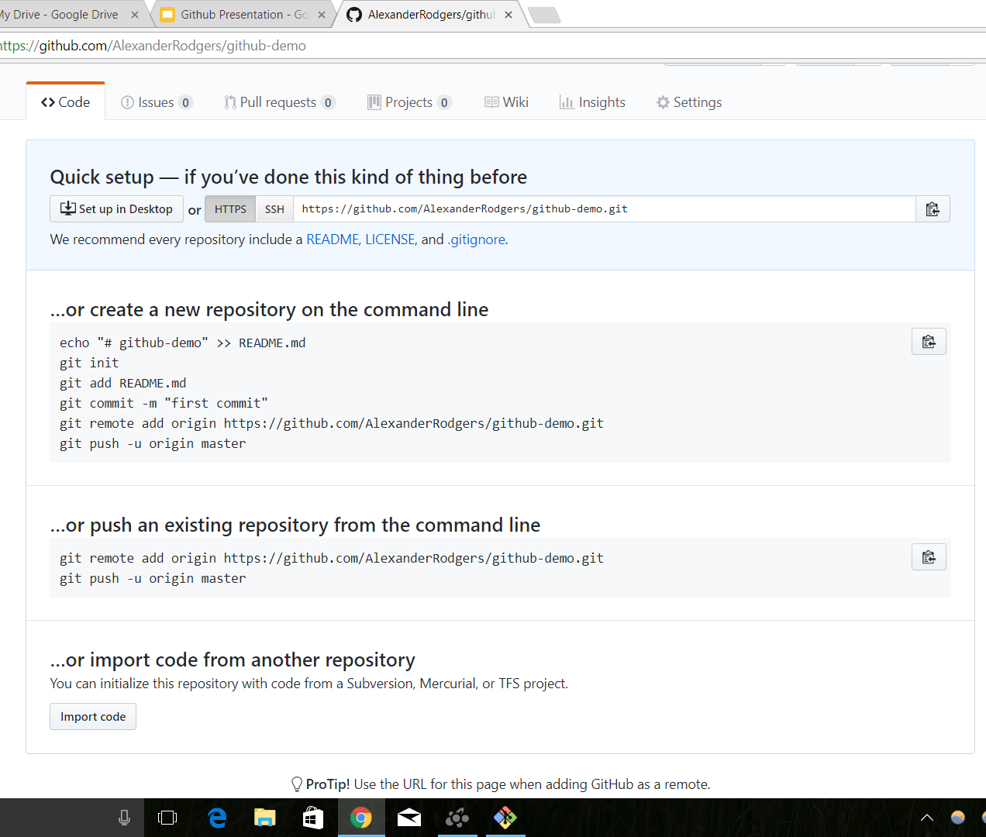
Create your First Repository
You should be seeing a webpage that looks something like this.
Don’t exit from this website just yet.

Slide 21
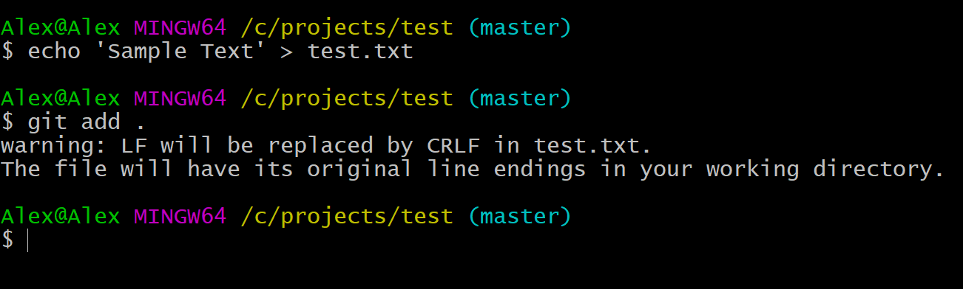
Create your First Repository
Let’s create a file to upload.
Create a .txt file through console.
Add the file to your project (the . means add all new files in the directory)
Don’t worry about the warning, it’s not important.

Slide 22
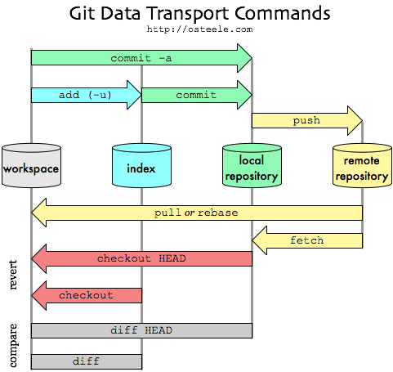
What are we doing?
We’re taking the code from our workspace and adding it to our local index (list of files in the project).
Basically that means we are specifying what files we want to be part of our project.

Slide 23
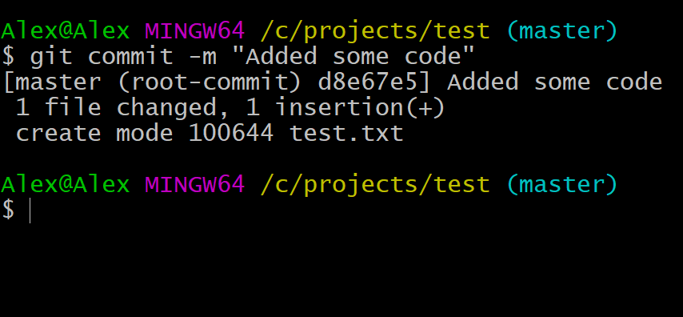
Create your first Repository
Once you are satisfied with your code commit it by using:
git commit -m “What changes you made to the project”
The -m of this command tells git bash that you are also sending a message about the changes you made to this project.
You should always add a commit message to the changes you made and be specific.

Slide 24
What are we doing?
We are setting the final version of all our code that will be added to the group project.
All the code that is committed is saved locally so that even if the code is changed, we can still use this version.

Slide 25
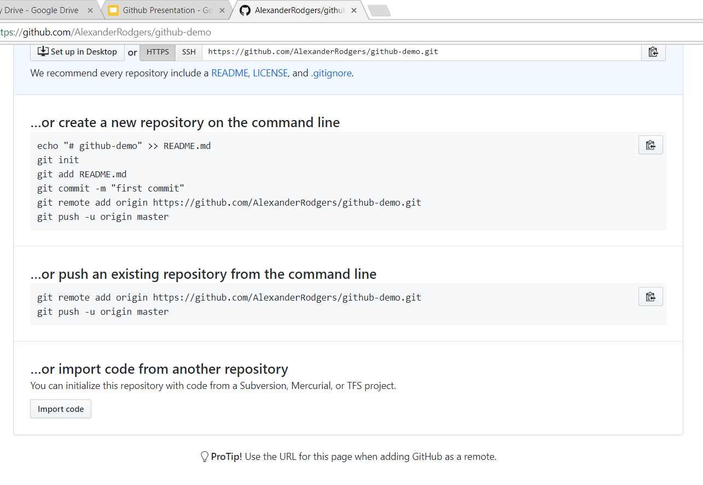
Create your First Repository
Go back to that website.
Click on the copy to clipboard button under the “push an existing repository from the command line” section.

Slide 26
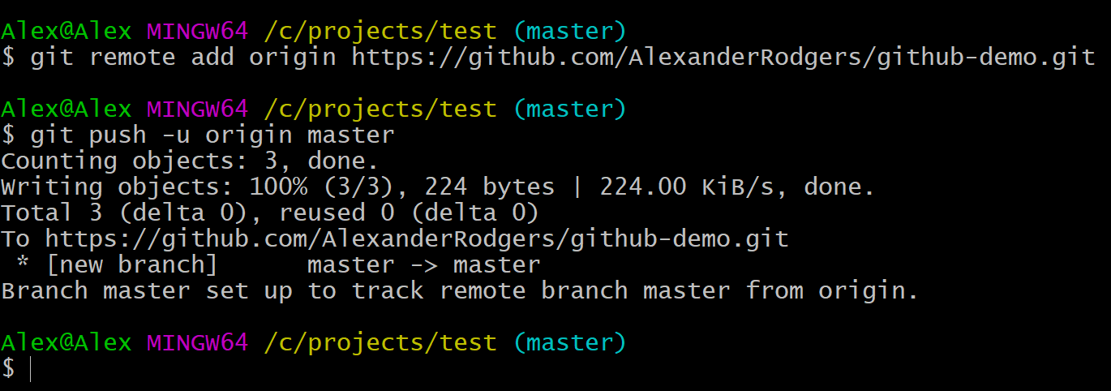
Create your First Repository
Paste the code you just copied into the terminal.
You can paste into the terminal by right clicking with your mouse and selecting copy or using the shift+insert keys
You may have to sign in. Just follow the instructions on the terminal.

Slide 27
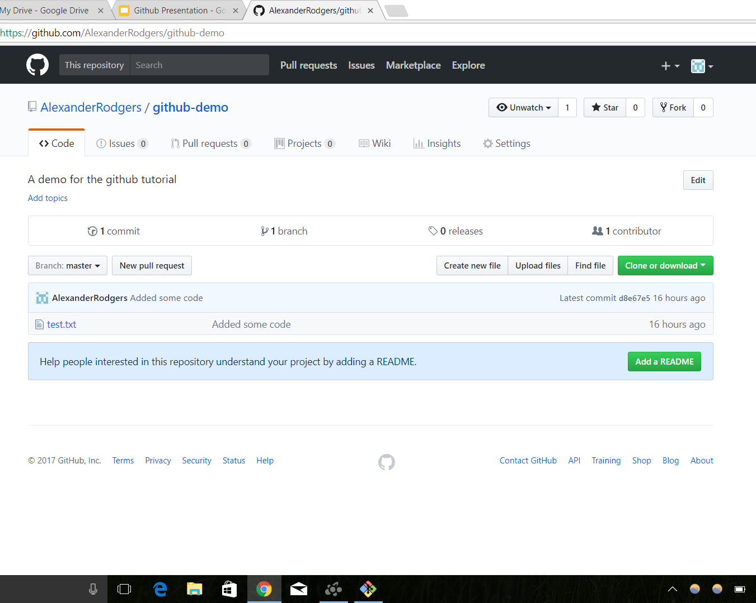
Create your First Repository
Refresh your browser and you should see that your file has been uploaded!

Slide 28
What did we do?
We uploaded our version of the project to the group project online.
Now anyone apart of the project can take the code you made and download it using git pull.

Slide 29
Sign up for the Github Education Pack
Go to https://education.github.com/pack
Verify Academic Status
Describe how you are going to use Github Education Pack (it does not have to be long)
Boom. Free stuff.

Slide 30
Additional Resources
Youtube:
TheNewBoston
LearnCode.Academy
https://guides.github.com/
https://try.github.io/levels/1/challenges/1

